Slide 1
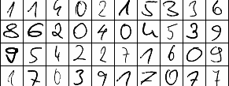
Digit Recognition
Holly Fallah

Slide 2
MNIST Data
MNIST - “Modified National Institute of Standards and Technology”
Dataset of pixels that produce an image of a handwritten digit.
Digits vary in handwriting styles and are not standardized.
784 Columns = 28x28 pixel
Each value within a pixel ranges from 0 to 255, inclusive, representing the black and white/grayscale intensity.
The higher the number, the lighter the intensity.
Kaggle Dataset
The data used for this project is a portion of the MNIST dataset provided by Kaggle.
Kaggle provided two datasets – a training dataset and a testing dataset.
Training dataset – 42,000 rows, 785 columns. One additional column used as a label indicating the value of the handwritten digit
Testing dataset – 28,000 rows, 784 columns

Slide 3
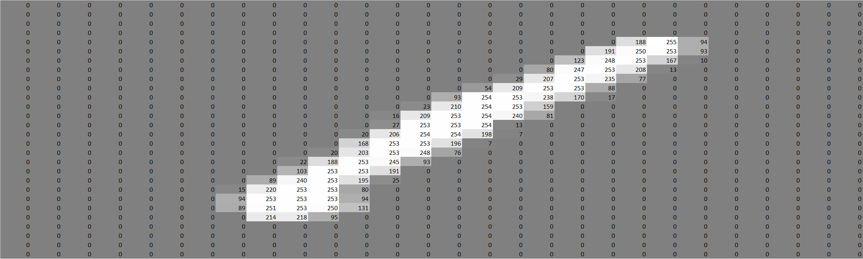

Data Exploration
Figure 1 and Figure 2 are different variations of the hand drawn digit “1”.
Each figure represents one row in the dataset, reshaped to a 28x28 pixel.
Notice the values within each pixel and how these values are associated with color intensity.
Larger values are closer to white, smaller values are closer to black.
Majority of image occupied by insignificant 0 data.
When the values in the pixel are compiled to produce an image, we see the following, as demonstrated in Figure 3 and Figure 4.
Figure 1
Figure 2
Figure 3
Figure 4

Slide 4
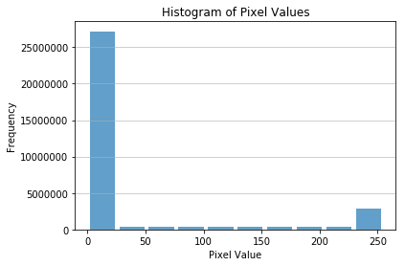
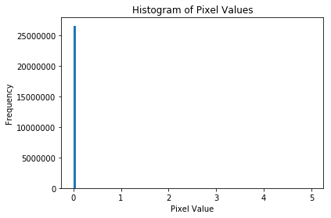
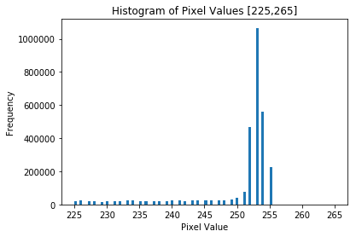
Data Exploration (II)
Figure 5 shows the distribution of intensity values for the entire train dataset.
Before doing any modeling, this histogram confirms what was seen in figures 1 and 2. Approximately 25,000,000 intensity values are 0.
Roughly 19% of the data is non-zero and actually contributes to the hand drawn digit.
Figure 5

Slide 5
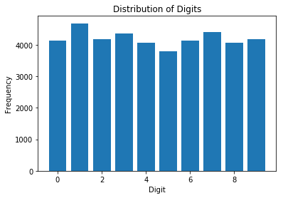
Data Exploration (III)
Figure 6 is a histogram of the distribution of hand drawn digits in the training dataset.
Based on the frequency counts in figures 6 and 7, the digit values are distributed evenly.
Figure 6
Digit | Frequency | Percentage
0 | 4132 | 9.84%
1 | 4684 | 11.15%
2 | 4177 | 9.95%
3 | 4351 | 10.36%
4 | 4072 | 9.70%
5 | 3795 | 9.04%
6 | 4137 | 9.85%
7 | 4401 | 10.48%
8 | 4063 | 9.67%
9 | 4188 | 9.97%
Figure 7

Slide 6
Algorithm Prep
Kaggle “Train”
Kaggle “Test”
In order to build a model, the first preparation step is to break up the Kaggle training dataset into its own test and train datasets.
Half of the data will be used to build the model, and the other half of the data will be used to check the accuracy of the model.
A 50/50 random split is done to create the ‘train’ and ‘test’.
“train”
“test”

Slide 7
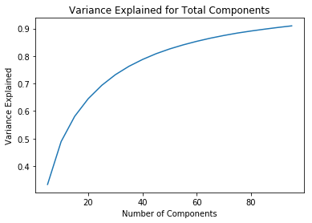
Algorithm Prep (II) - Reducing Dimensionality
As mentioned previously, 81% of the data takes up blank space, and 19% of the data contribute to the hand drawn digit.
Therefore, by using principal component analysis (PCA), we can reduce the dimensionality of the data.
PCA is a method that limits a wide set of variables to just a few principal components which explain a majority of the variation within the data.
How many components? Figure 8 is a plot of the variance explained for the number of components chosen for the PCA.
Although it may seem like the best decision would be to use 100 components which explain 90% of the variance in the data, it is important to be mindful of overfitting. Therefore, the appropriate number of components should be a parameter to test within the model.
Figure 8

Slide 8
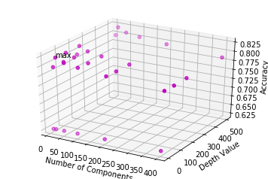
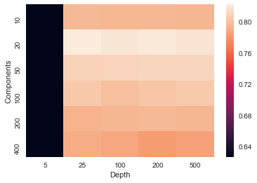
Model 1 - PCA + Decision Tree
Figure 9
This first model deducts patterns from the PCA components as a decision tree.
Decision tree classifiers make selections based on a set of criteria that computes the importance of each attribute.
The variable to test for the decision tree is the “max depth” feature, which indicates maximum depth of the tree, or the number of pathways the tree creates.
Max depth is also a parameter that is tested in the model.
Figures 9 and 10 show the test accuracy of combinations of PCA components and decision tree depth.
20 components and a depth of 25 gives us the best accuracy of 82% for the model.
Figure 10

Slide 9
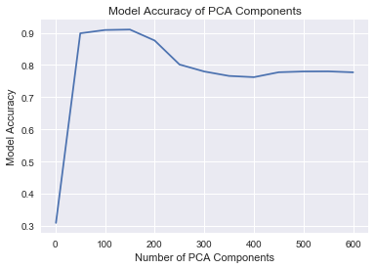
Model 2 - PCA + Logistic Regression
Logistic regression explains the relationship between a dependent binary variable and many features.
For model 2, PCA reduces the data to key features, and these features are used as inputs to the regression.
The number of PCA components is the parameter used to estimate the model with the highest accuracy.
Figure 11 plots the model accuracy and the number of PCA components.
The model with 250 components gives us the best accuracy of 91.3%.
Notice that a saturation takes place where the highest accuracy is reached, and additional components over time decline in accuracy. This is due to overfitting of the model where the model becomes too specific to the train data that it loses its robustness for other datasets.
Figure 11

Slide 10
Conclusion
Model 1 – PCA + Decision Tree
Accuracy 82%
Model 2 – PCA + Logistic Regression
Accuracy 91%
Model 2 predicts the accuracy of identifying the hand drawn digit better than Model 1 can.
Code: https://github.com/hollyfallah/Digit-Recognition

